Slide 1
UNIT 3 IMAGE ENHANCEMENT IN FREQUENCY DOMAIN
6 Hrs
Prepared by
Er.Harendra Bikram Shah (Lecturer)
Department of Computer Engineering

Slide 2
OUTLINES
3.1. Introduction to Fourier Transform and the frequency Domain
3.2. Computing and Visualizing the 2D DFT
3.3. Smoothening Frequency Domain Filters
3.4. Sharpening Frequency Domain Filters
3.5. Other Image Transforms
3.5.1. Hadamard Transform
3.5.2. Haar Transform
3.5.3. Discrete Cosine Transform
3.6. Fast Fourier Transform

Slide 3
Introduction to Fourier Transform and the frequency Domain
A digital image is converted from spatial domain to frequency domain and image filtering is used for image enhancement for a specific application.
There are two types of filters: High pass filters and low pass filters
For smoothing an image: low filter
For Sharpening an image: High Filter
low pass filters and high pass filters have sub categorized i. e.
Ideal filter
Butterworth filter
Gaussian filter

Slide 4
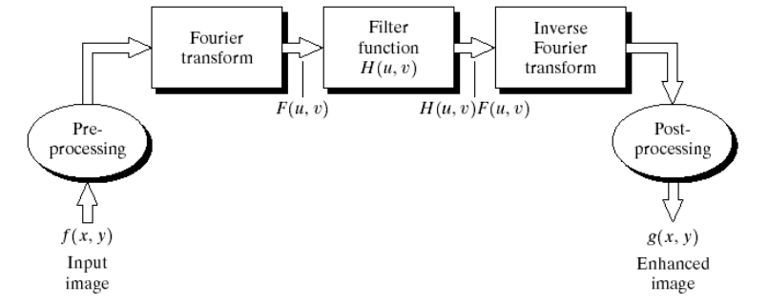
IMAGE ENHANCEMENT IN FREQUENCY DOMAIN

Slide 5
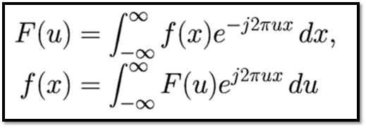
FOURIER TRANSFORMATION
mathematical model which helps to transform the signals between two different domains
tool for image processing. it is used for decomposing an image into sine and cosine components.
The inverse Fourier transform brings back the image in spatial domain from frequency domain.
used in image filtering, image compression. Image analysis and image reconstruction etc.
The formula for 1-D Fourier transformation and 1-D Inverse Fourier Transformation is given below:

Slide 6
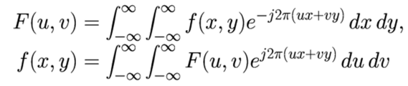
FOURIER TRANSFORMATION
2D Fourier transform and 2D Inverse Fourier Transform:

Slide 7
Properties Fourier Transformation
Duality
Linear transform
Modulation property
Parseval’s theorem
Linearity:
Scaling:
Differentiation:
Convolution:

Slide 8
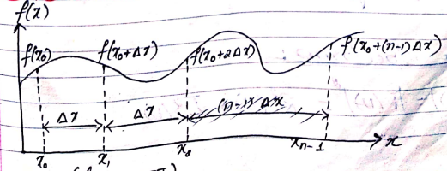
Discrete Fourier Transform
The Discrete Fourier Transform (DFT) is a specific kind of discrete transform, used in Fourier analysis

Slide 9


Discrete Fourier Transform
The Discrete Fourier Transform (DFT) is a specific kind of discrete transform, used in Fourier analysis
It is defined as:
The 1D Discrete Fourier Transform of an image is given by:
Where k is 0.1.2…. N-1
Here u is K
The 1D Inverse Discrete Fourier Transform of an image is given by:
Where n is 0,2., 3…N-1
Here x is n according to our class lecturers.

Slide 10
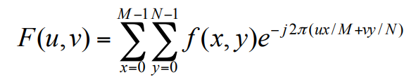
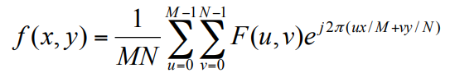
Discrete Fourier Transform
The 2D discrete Fourier transform (DFT) of an image f of size M×N is an image F of same size defined as:
for u = 0, 1, 2…M-1 and v = 0, 1, 2…N-1.
• The inverse 2D-DFT is given by:
for x = 0, 1, 2…M-1 and y = 0, 1, 2…N-1

Slide 11
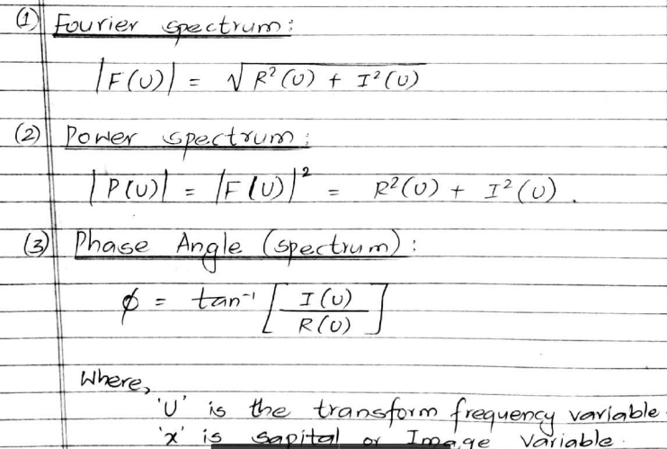
Discrete Fourier Transform

Slide 12
Discrete Fourier Transform
The Transform matrix of DFT is given by
1 1 1 1
1 -j -1 j
1 -1 1 -1
1 j -1 -j 4x4
To calculate the DFT using matrix method
For 1D image
F=M.f
For 2D Image
F=M.f.MT
Since the dft is symmetric the M and MT are same
Here M is the DFT transform matrix
n
WN=e
(-j2π/N)*n

Slide 13
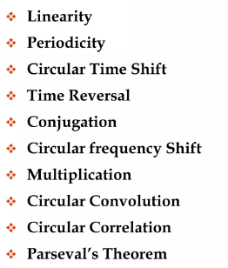
Properties of Discrete Fourier Transform

Slide 14
Application of Discrete Fourier Transform
Signal analysis
Sound filtering
Data compression
Cross correlation
Matched filtering
System identification
Power spectrum estimation
Display signal and spectrum

Slide 15
Questions on DFT

Slide 16
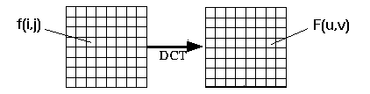
Discrete Cosine Transformation
The DCT is similar to the discrete Fourier transform: it transforms a signal or image from the spatial domain to the frequency domain
DCT only deals with Real values.

Slide 17
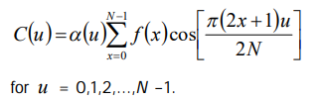
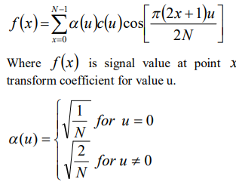
Discrete Cosine Transformation
One-Dimensional DCT If we have one-D sequence of signal value of length N then its equivalent 1D-DCT can be expressed as
1D-IDCT can be expressed as

Slide 18
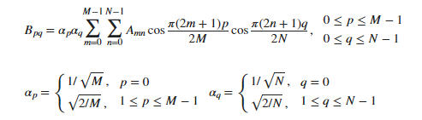
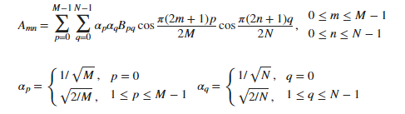
Discrete Cosine Transformation
The two-dimensional DCT of an M-by-N matrix A is defined as follows:
2D-IDCT can be expressed as

Slide 19
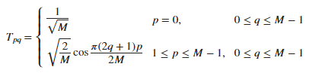
Discrete Cosine Transformation
The DCT Transform Matrix
0.5 0.5 0.5 0.5
0.653 0.2705 -0.2705 -0.653
0.5 -0.5 -0.5 0.5
0.2705 -0.653 0.653 -0.2705 4x4

Slide 20
Discrete Cosine Transformation
The DCT Transform Matrix
0.5 0.5 0.5 0.5
0.653 0.2705 -0.2705 -0.653
0.5 -0.5 -0.5 0.5
0.2705 -0.653 0.653 -0.2705 4x4
For 1D image
F=C.f
For 2D Image
F=C.f. C^{T}
Since the DCT is not symmetric the C and C^{T} are not same

Slide 21
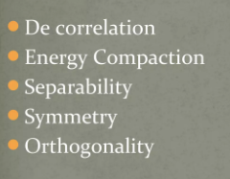
Discrete Cosine Transformation
Applications of DCT:
DCTs are widely used in encoding, decoding, video, audio, multiplexing and analog to digital conversion.
DCTs are also commonly used for High-definition Television (HDTV) encoder/decoder chips.
DCT is widely used in JPEG compression as well.
Properties of DCT:

Slide 22
Questions on DCT

Slide 23
Hadamard Transform
The Hadamard transform, named after the French mathematician Jacques Hadamard, is a mathematical operation that transforms a set of data into a different representation.
It is 1D non sinusoidal signal
It is transformed for the complete set of orthogonal square functions.
Its coefficient are real and lies between -1 to +1.
Application of Hadamard in Image processing
Image Compression
Denoising
Pattern Recognition
Image Encryption
Image Equalization
Properties of Hadamard Transform
Orthogonality:
Symmetry:
Self-Invertibility:
Binary Nature:
Efficiency in Matrix Multiplication:
Good Spread of Values:

Slide 24
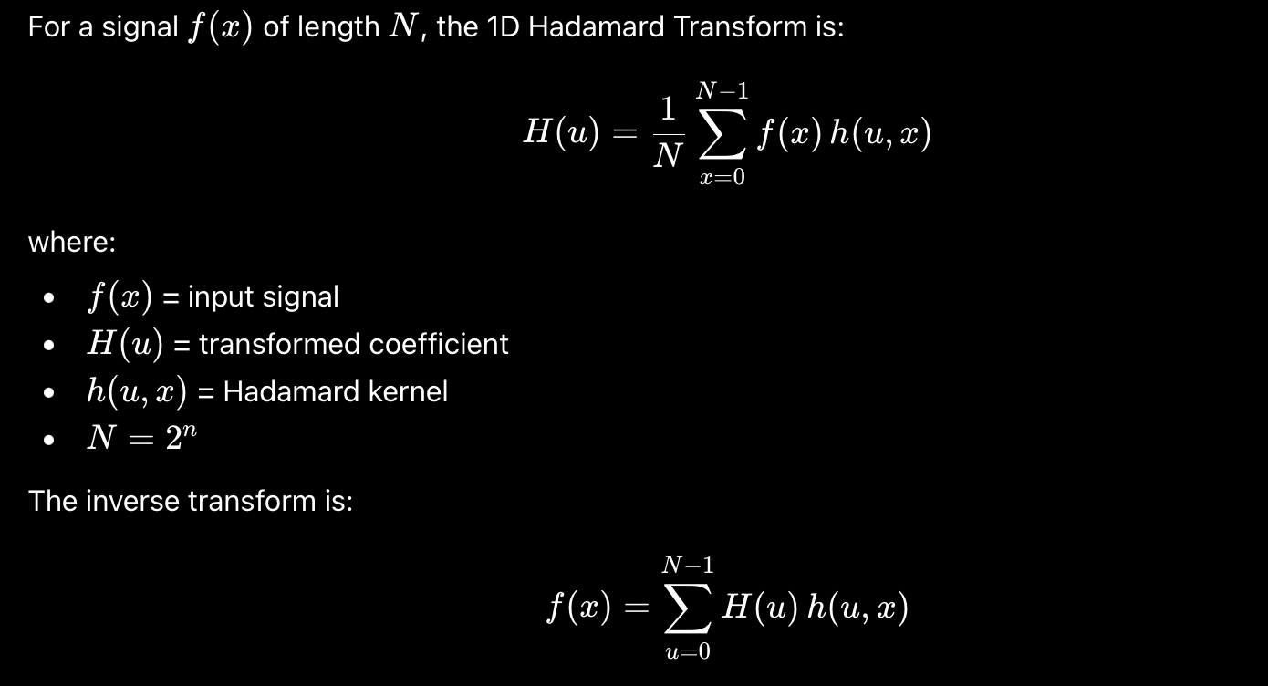
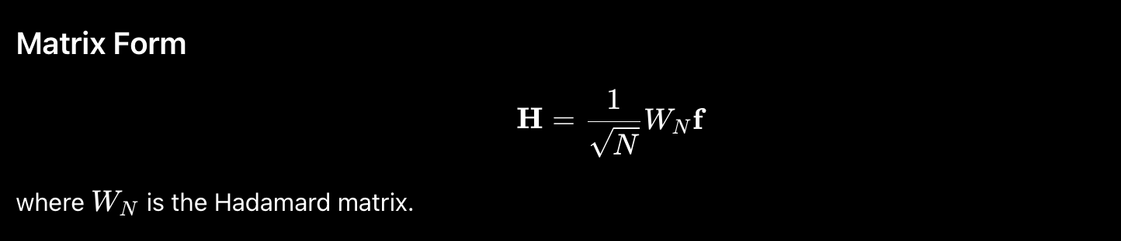
The 1D Hadamard transform is given by:

Slide 25
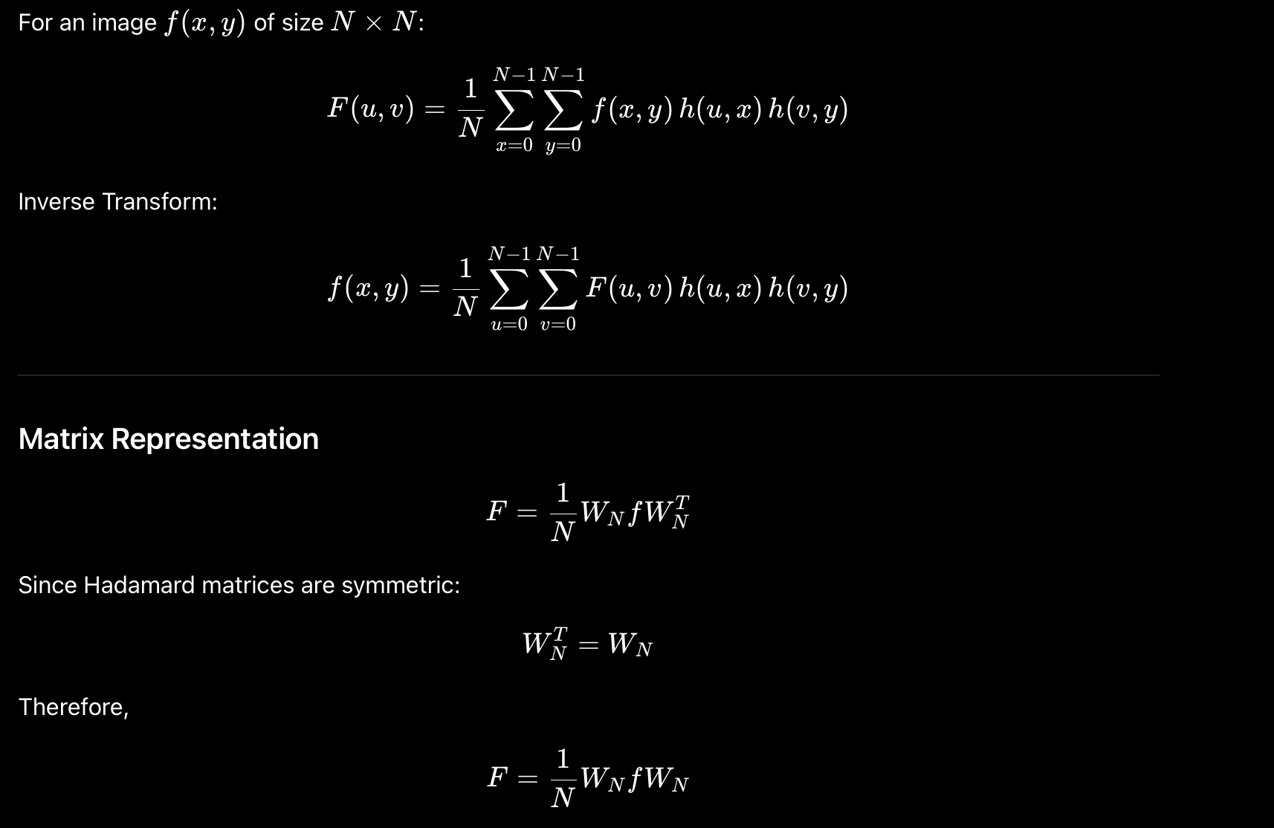
The 2D Hadamard transform kernel is given by:

Slide 26
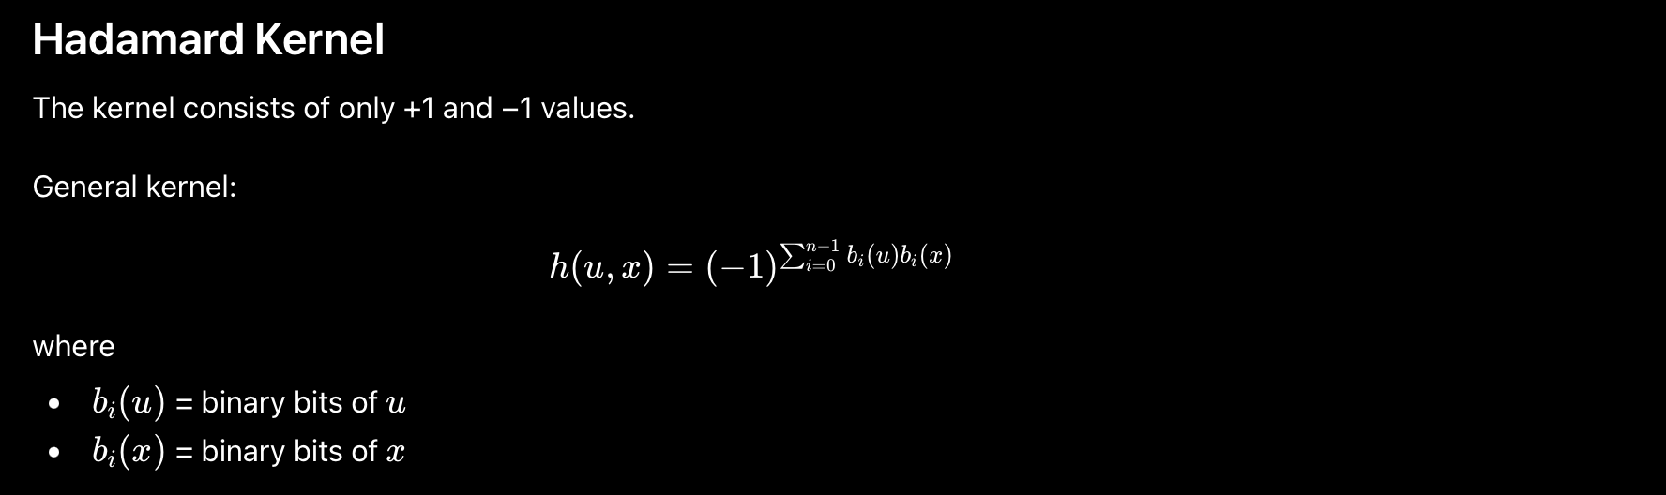
HADAMARD KERNEL

Slide 27
Deriving the Hadamard transform kernel of order N=2:

Slide 28
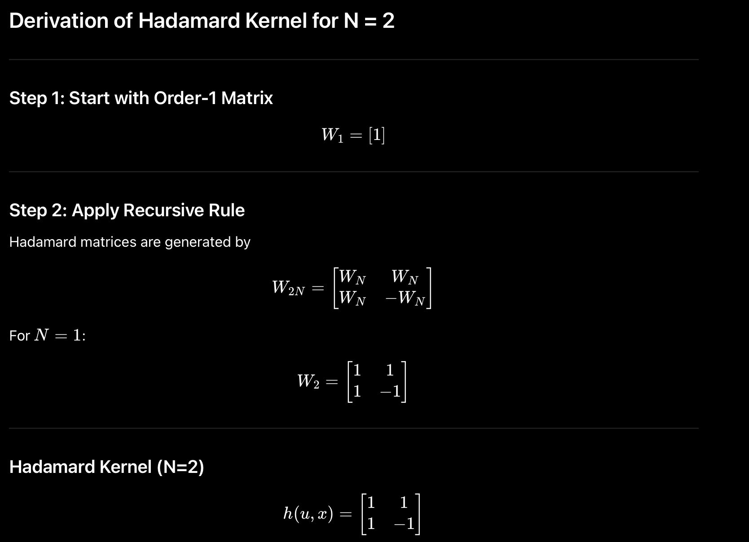
Deriving the Hadamard transform kernel of order N=2:

Slide 29

Deriving the Hadamard transform kernel of order N=2:

Slide 30
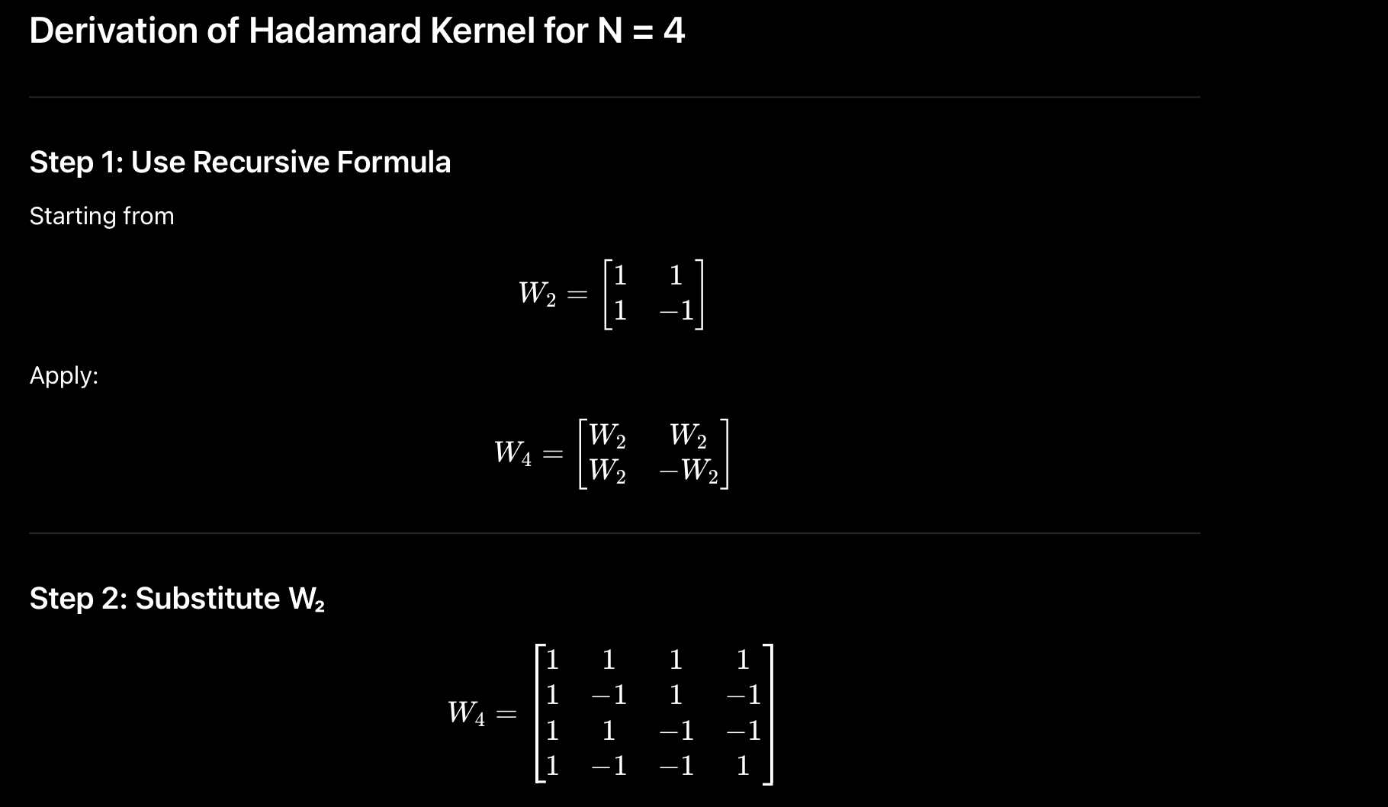
Deriving the Hadamard transform kernel of order N=4:

Slide 31
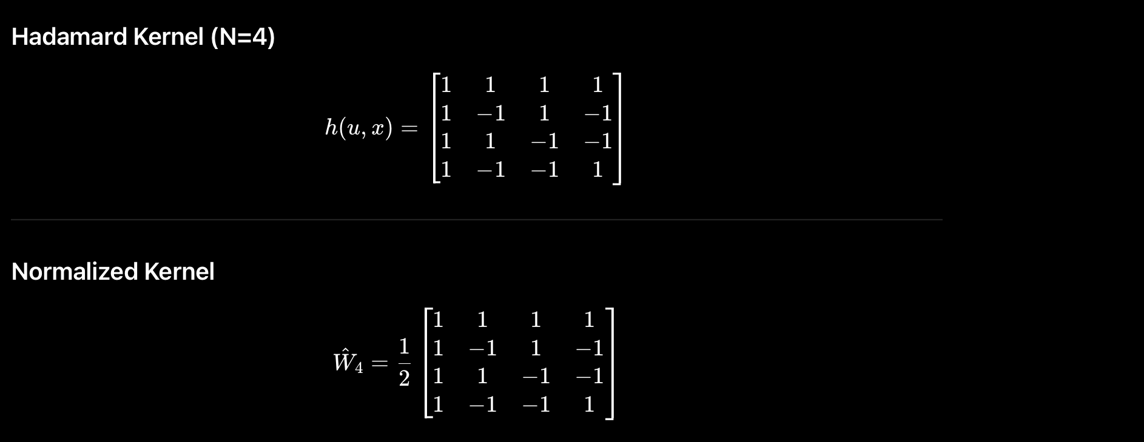
Deriving the Hadamard transform kernel of order N=4:

Slide 32
Hadamard Transform
1 1
-1 2x2
Order of N=2 i.e. H=
1/√2
Normalized Hadamard Kernel
1 1 1 1
1 -1 1 -1
1 1 -1 -1
1 -1 -1 1 4x4
H2 H2
H2 -H2 2x2
Order of N=4 i.e. H=
1/√4
=
1/2
Kernel Matrix and Transpose of Kernel Matrix are same
T
T
T=K.F.K
F=K.T.K
For Forward Transform
For Inverse Transform

Slide 33
Haar Transform
The Haar transform is a mathematical transformation technique used in signal processing and image analysis.
It is a type of wavelet transform that represents a signal or an image in terms of its local variations, allowing for a multi-resolution analysis.
It was proposed by Haar in 1910
The Haar matrix or kernel is consist of +1,-1,0 and multiplied by √2
Applications
Image Compression:
Signal Compression:
Edge Detection:
Biometric Authentication:
Data Denoising:
Medical Imaging:
Video Compression:
Properties of Haar transform
Orthogonality:
Simple Basis Functions:
Localization in Time and Frequency:
Energy Compaction:
Fast Implementation:
Non-Sinusoidal

Slide 34
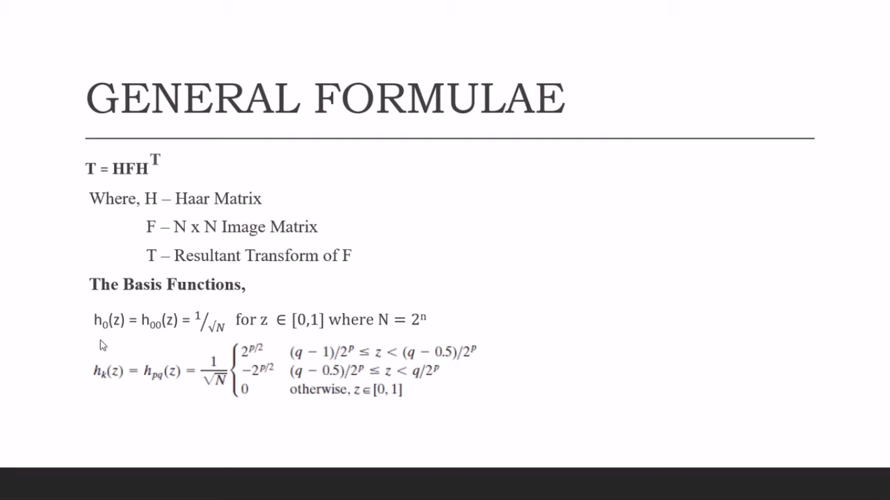
=

Slide 35
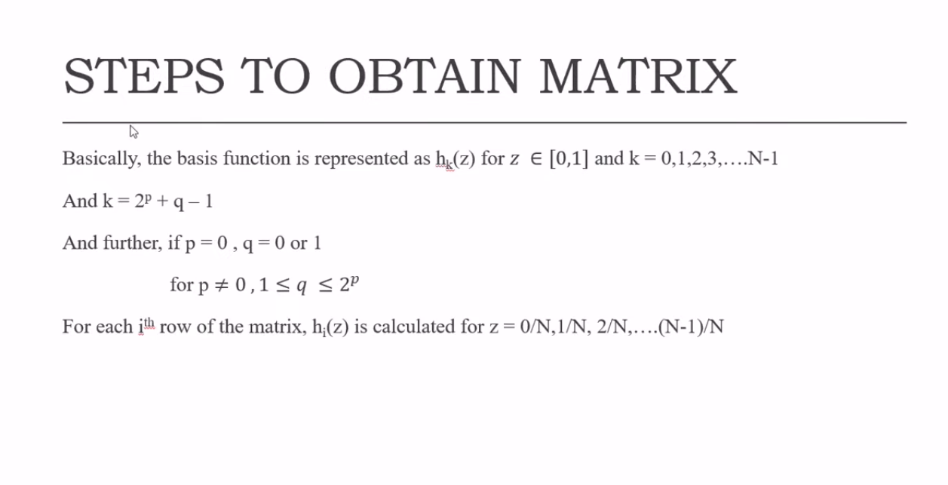
=

Slide 36
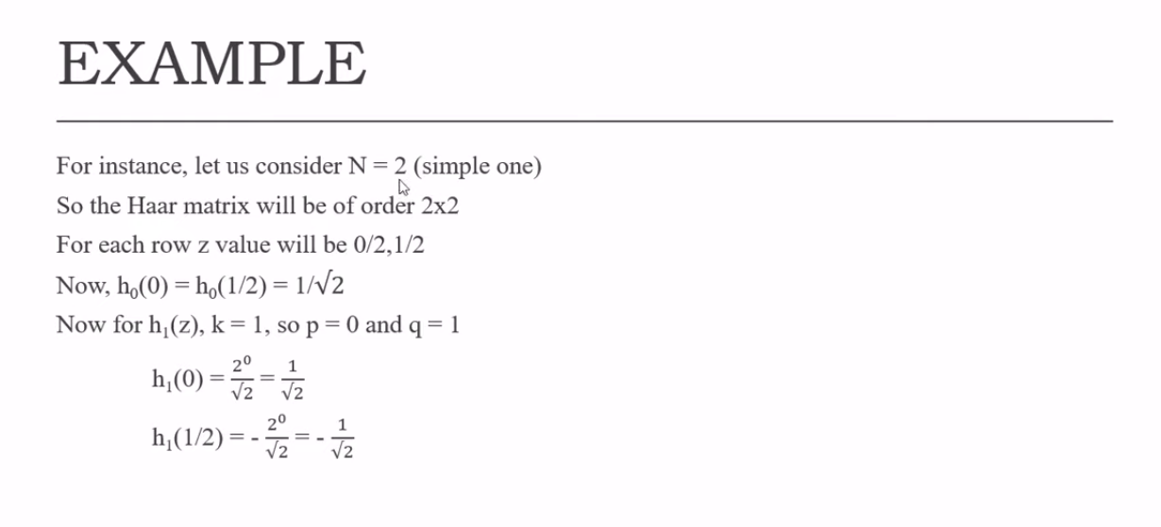
=

Slide 37
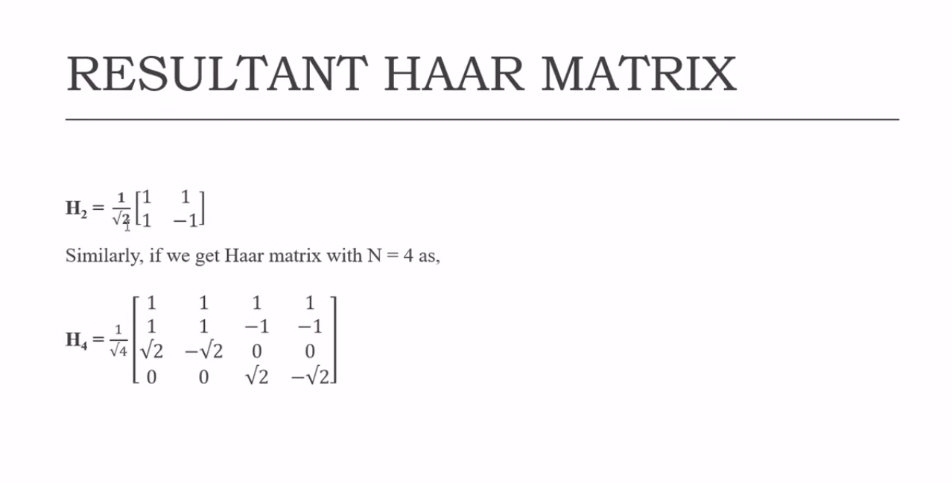
=
Kernel Matrix and transpose of Kernel Matrix are not same
T
H=H
T=H.F.H
T
F=H.T.H
For Forward Transform
For Inverse Transform

Slide 38
Fast Fourier Transform (FFT)
The Fast Fourier Transform (FFT) is an algorithm for efficiently computing the discrete Fourier transform (DFT) and its inverse.
The FFT algorithm was developed to significantly reduce the computation time required for the DFT, especially for large input sizes.
FFT is a DFT which reduces the number of computations needed for points from 2N to 2NlogN
2
Properties of FFT
Computational Efficiency:
Divide-and-Conquer Strategy:
Orthogonality:
Linearity:
Efficiency Across Multiple Platforms:
Applications in Real and Complex Domains:
Applications in Signal and Image Processing:
Application of FFT
Signal Processing:
Audio Processing:
Image Processing:
Communication Systems:
Control Systems:
Vibration Analysis:
Speech Processing:
Scientific Research:

Slide 39
THANK YOU

Slide 40
End of UNIT 3

